Slide 1
Introduction to Programming
Session 10
Collections in Java

Slide 2
Objectives
Java Collections.
Methods of Collection interface
ArrayList
Demo ArrayList
Stack
Demo Stack
Queue.
Demo Queue

Slide 3
Java Collections
The Collection in Java is a framework that provides an architecture to store and manipulate the group of objects.
Java Collections can achieve all the operations that you perform on a data such as searching, sorting, insertion, manipulation, and deletion.
Java Collection means a single unit of objects. Java Collection framework provides many interfaces (Set, List, Queue, Deque) and classes (ArrayList, Vector, LinkedList, PriorityQueue, HashSet, LinkedHashSet, TreeSet).
The Collection interface (java.util.Collection) and Map interface (java.util.Map) are the two main “root” interfaces of Java collection classes.

Slide 4
Java Collections
Benefits of Java Collections Framework:
  Reduced Development Effort – It comes with almost all common types of collections and useful methods to iterate and manipulate the data. So we can concentrate more on business logic rather than designing our collection APIs.
  Increased Quality – Using core collection classes that are well tested increases our program quality rather than using any home developed data structure.
  Reusability and Interoperability
  Reduce effort – to learn any new API if we use core collection API classes.

Slide 5
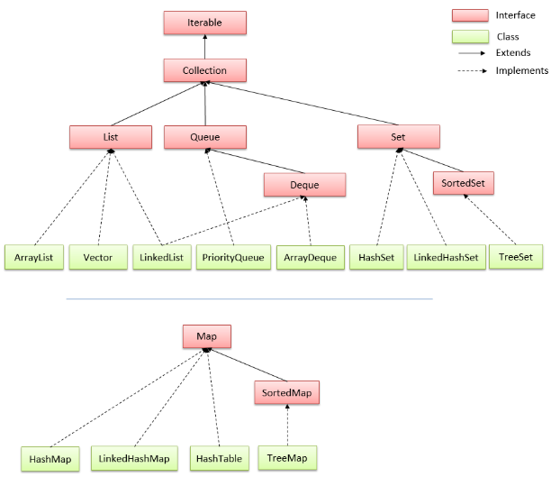
Hierarchy of Collection Framework

Slide 6
Methods of Collection interface
No. | Method | Description
1 | public boolean add(E e) | It is used to insert an element in this collection.
2 | public boolean addAll(Collection<? extends E> c) | It is used to insert the specified collection elements in the invoking collection.
3 | public boolean remove(Object element) | It is used to delete an element from the collection.
4 | public boolean removeAll(Collection<?> c) | It is used to delete all the elements of the specified collection from the invoking collection.
5 | default boolean removeIf(Predicate<? super E> filter) | It is used to delete all the elements of the collection that satisfy the specified predicate.
6 | public boolean retainAll(Collection<?> c) | It is used to delete all the elements of invoking collection except the specified collection.
7 | public int size() | It returns the total number of elements in the collection.
8 | public void clear() | It removes the total number of elements from the collection.
9 | public boolean contains(Object element) | It is used to search an element.

Slide 7
Methods of Collection interface
No. | Method | Description
10 | public boolean containsAll(Collection<?> c) | It is used to search the specified collection in the collection.
11 | public Iterator iterator() | It returns an iterator.
12 | public Object[] toArray() | It converts collection into array.
13 | public <T> T[] toArray(T[] a) | It converts collection into array. Here, the runtime type of the returned array is that of the specified array.
14 | public boolean isEmpty() | It checks if collection is empty.
15 | public boolean equals(Object element) | It matches two collections.
16 | public int hashCode() | It returns the hash code number of the collection.

Slide 8
Methods of Iterator interface
There are only three methods in the Iterator interface. They are:
No. | Method | Description
1 | public boolean hasNext() | It returns true if the iterator has more elements otherwise it returns false.
2 | public Object next() | It returns the element and moves the cursor pointer to the next element.
3 | public void remove() | It removes the last elements returned by the iterator. It is less used.

Slide 9
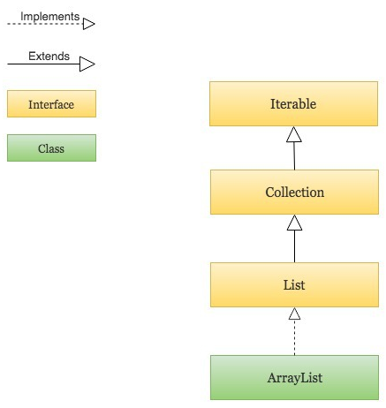
Java ArrayList
ArrayList in Java is used to store dynamically sized collection of elements. Contrary to Arrays that are fixed in size, an ArrayList grows its size automatically when new elements are added to it.
ArrayList is part of Java’s collection framework and implements Java’s List interface, it is in the package java.util.ArrayList

Slide 10
Java ArrayList
Following are few key points to note about ArrayList in Java:
An ArrayList is a re-sizable array, also called a dynamic array. It grows its size to accommodate new elements and shrinks the size when the elements are removed.
ArrayList internally uses an array to store the elements. Just like arrays, It allows you to retrieve the elements by their index.
Java ArrayList allows duplicate and null values.
Java ArrayList is an ordered collection. It maintains the insertion order of the elements.
You cannot create an ArrayList of primitive types like int, char etc. You need to use boxed types like Integer, Character, Boolean etc.
Java ArrayList is not synchronized. If multiple threads try to modify an ArrayList at the same time, then the final outcome will be non-deterministic. You must explicitly synchronize access to an ArrayList if multiple threads are gonna modify it.

Slide 11
Java ArrayList
Creating an ArrayList and adding new elements to it: using ArrayList() constructor and add() method.
import java.util.ArrayList;
import java.util.List;
public class CreateArrayListExample {
public static void main(String[] args) {
List<String> animals = new ArrayList<>(); // Creating an ArrayList of String
// Adding new elements to the ArrayList
animals.add("Lion");
animals.add("Tiger");
animals.add("Cat");
animals.add("Dog");
System.out.println(animals);
// Adding an element at a particular index in an ArrayList
animals.add(2, "Elephant");
System.out.println(animals);
}
}
Output:
[Lion, Tiger, Cat, Dog]
[Lion, Tiger, Elephant, Cat, Dog]

Slide 12
Java ArrayList
Creating an ArrayList from another collection: using the ArrayList(Collection c) constructor and addAll() method.
import java.util.ArrayList;
import java.util.List;
public class CreateArrayListFromCollectionExample {
public static void main(String[] args) {
List<Integer> firstFivePrimeNumbers = new ArrayList<>();
firstFivePrimeNumbers.add(2);
firstFivePrimeNumbers.add(3);
firstFivePrimeNumbers.add(5);
// Creating an ArrayList from another collection
List<Integer> firstTenPrimeNumbers = new ArrayList<>(firstFivePrimeNumbers);
List<Integer> nextFivePrimeNumbers = new ArrayList<>();
nextFivePrimeNumbers.add(13);
nextFivePrimeNumbers.add(17);
// Adding an entire collection to an ArrayList
firstTenPrimeNumbers.addAll(nextFivePrimeNumbers);
System.out.println(firstTenPrimeNumbers);
}
}
Output:
[2, 3, 5, 13, 17]

Slide 13
Java ArrayList
Accessing elements from an ArrayList: using the isEmpty(), the size(), the get() and the set() method.
import java.util.ArrayList;
import java.util.List;
public class AccessElementsFromArrayListExample {
public static void main(String[] args) {
List<String> topCompanies = new ArrayList<>();
System.out.println("Is the topCompanies list empty? : " + topCompanies.isEmpty()); // Check if an ArrayList is empty
topCompanies.add("Google");
topCompanies.add("Apple");
topCompanies.add("Microsoft");
// Find the size of an ArrayList
System.out.println("Here are the top " + topCompanies.size() + " companies in the world");
System.out.println(topCompanies);
String bestCompany = topCompanies.get(0); // Retrieve the element at a given index
String secondBestCompany = topCompanies.get(1);
String lastCompany = topCompanies.get(topCompanies.size() - 1);
System.out.println("Best Company: " + bestCompany);
System.out.println("Second Best Company: " + secondBestCompany);
System.out.println("Last Company in the list: " + lastCompany);
topCompanies.set(2,"Walmart"); // Modify the element at a given index
System.out.println("Modified top companies list: " + topCompanies);
}
}
Output:
Is the topCompanies list empty? : true
Here are the top 3 companies in the world
[Google, Apple, Microsoft]
Best Company: Google
Second Best Company: Apple
Last Company in the list: Microsoft
Modified top companies list: [Google, Apple, Walmart]

Slide 14
Java ArrayList
Removing elements from an ArrayList: using the remove(int index) , the remove(Object o), the removeAll(), the removeIf() and the clear() method.
import java.util.ArrayList;
import java.util.List;
import java.util.function.Predicate;
public class RemoveElementsFromArrayListExample {
public static void main(String[] args) {
List<String> programmingLanguages = new ArrayList<>();
programmingLanguages.add("C");
programmingLanguages.add("C++");
programmingLanguages.add("Java");
programmingLanguages.add("Kotlin");
programmingLanguages.add("Python");
programmingLanguages.add("Perl");
programmingLanguages.add("Ruby");
System.out.println("Initial List: " + programmingLanguages);
programmingLanguages.remove(5); // Remove the element at index `5`
System.out.println("After remove(5): " + programmingLanguages);
// Remove the first occurrence of the given element from the ArrayList
// (The remove() method returns false if the element does not exist in the ArrayList)
boolean isRemoved = programmingLanguages.remove("Kotlin");
System.out.println("After remove(\"Kotlin\"): " + programmingLanguages);

Slide 15
Java ArrayList
Output:
Initial List: [C, C++, Java, Kotlin, Python, Perl, Ruby]
After remove(5): [C, C++, Java, Kotlin, Python, Ruby]
After remove("Kotlin"): [C, C++, Java, Python, Ruby]
After removeAll(scriptingLanguages): [C, C++, Java]
After Removing all elements that start with "C": [Java]
After clear(): []
// Remove all the elements that exist in a given collection
List<String> scriptingLanguages = new ArrayList<>();
scriptingLanguages.add("Python");
scriptingLanguages.add("Ruby");
scriptingLanguages.add("Perl");
programmingLanguages.removeAll(scriptingLanguages);
System.out.println("After removeAll(scriptingLanguages): " + programmingLanguages);
// Remove all the elements that satisfy the given predicate
programmingLanguages.removeIf(new Predicate<String>() {
@Override
public boolean test(String s) {
return s.startsWith("C");
}
});
System.out.println("After Removing all elements that start with \"C\": " + programmingLanguages);
// Remove all elements from the ArrayList
programmingLanguages.clear();
System.out.println("After clear(): " + programmingLanguages);
}
}

Slide 16
Java ArrayList
Iterating over an ArrayList using iterator() ,forEach and for.
import java.util.ArrayList;
import java.util.Iterator;
import java.util.List;
public class IterateOverArrayListExample {
public static void main(String[] args) {
List<String> tvShows = new ArrayList<>();
tvShows.add("Breaking Bad"); tvShows.add("Game Of Thrones");
tvShows.add("Friends"); tvShows.add("Prison break");
System.out.println("=== Iterate using Java 8 forEach and lambda ===");
tvShows.forEach(tvShow -> { System.out.println(tvShow);});
System.out.println("\n=== Iterate using an iterator() ===");
Iterator<String> tvShowIterator = tvShows.iterator();
while (tvShowIterator.hasNext()) {
String tvShow = tvShowIterator.next();
System.out.println(tvShow);
}
System.out.println("\n=== Iterate using for loop with index ===");
for(int i = 0; i < tvShows.size(); i++) {
System.out.println(tvShows.get(i));
}
}
}
Output:
=== Iterate using Java 8 forEach and lambda ===
Breaking Bad
Game Of Thrones
Friends
Prison break
=== Iterate using an iterator() ===
Breaking Bad
Game Of Thrones
Friends
Prison break
=== Iterate using for loop with index ===
Breaking Bad
Game Of Thrones
Friends
Prison break

Slide 17
Java ArrayList
Searching for elements in an ArrayList using the contains(), the indexOf() and lastIndexOf() method
import java.util.ArrayList;
import java.util.List;
public class SearchElementsInArrayListExample {
public static void main(String[] args) {
List<String> names = new ArrayList<>();
names.add("John");
names.add("Alice");
names.add("Bob");
names.add("Steve");
names.add("John");
names.add("Steve");
names.add("Maria");
// Check if an ArrayList contains a given element
System.out.println("Does names array contain \"Bob\"? : " + names.contains("Bob"));
// Find the index of the first occurrence of an element in an ArrayList
System.out.println("indexOf \"Steve\": " + names.indexOf("Steve"));
System.out.println("indexOf \"Mark\": " + names.indexOf("Mark"));
// Find the index of the last occurrence of an element in an ArrayList
System.out.println("lastIndexOf \"John\" : " + names.lastIndexOf("John"));
System.out.println("lastIndexOf \"Bill\" : " + names.lastIndexOf("Bill"));
}
}
Output:
Does names array contain "Bob"? : true
indexOf "Steve": 3
indexOf "Mark": -1
lastIndexOf "John" : 4
lastIndexOf "Bill" : -1

Slide 18
Java ArrayList
Sorting an ArrayList using the Collections.sort() and ArrayList.sort() method
import java.util.ArrayList;
import java.util.Collections;
import java.util.List;
public class ArrayListCollectionsSortExample {
public static void main(String[] args) {
List<Integer> numbers = new ArrayList<>();
numbers.add(13); numbers.add(7); numbers.add(18); numbers.add(5);
System.out.println("Before : " + numbers);
// Sorting an ArrayList using Collections.sort() method
Collections.sort(numbers);
System.out.println("After : " + numbers);
List<String> names = new ArrayList<>();
names.add("Lisa"); names.add("Jennifer");
names.add("Mark"); names.add("David");
System.out.println("Names : " + names);
// Sort an ArrayList using its sort() method. You must pass a Comparator to the ArrayList.sort() method.
names.sort(new Comparator<String>() {
@Override
public int compare(String name1, String name2) { return name1.compareTo(name2); }
});
System.out.println("Sorted Names : " + names);
}
}
Output:
Before : [13, 7, 18, 5]
After : [5, 7, 13, 18]
Names : [Lisa, Jennifer, Mark, David]
Sorted Names : [David, Jennifer, Lisa, Mark]

Slide 19
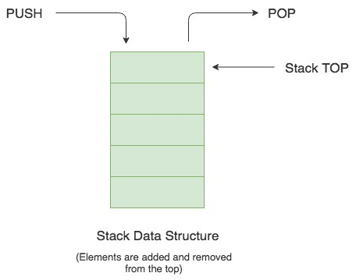
What is a Stack?
A Stack is a Last In First Out (LIFO) data structure.
It supports two basic operations called push and pop. The push operation adds an element at the top of the stack, and the pop operation removes an element from the top of the stack.

Slide 20
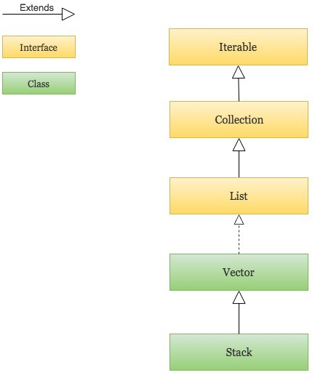
Java Stack
Java provides a Stack class which models the Stack data structure. The Stack class is part of Java’s collections framework.
The Stack class extends Vector which implements the List interface. A Vector is a re-sizable collection. It grows its size to accommodate new elements and shrinks the size when the elements are removed.
It also grows and shrinks its size as needed when new elements are added or removed.
It is in the package java.util.Stack;

Slide 21
Java Stack
Some common methods:
No. | Method | Description
1 | public void Stack() | It is a constructor of stack and used to create an empty stack.
2 | public Object push(Object element) | It is used to insert a specific element into the stack and returns the inserted element.
3 | public Object pop() | It is used to remove the top element from the stack and returns the removed element.
4 | public Object peek() | is used to return the first element of the stack, but it does not remove from the top.
5 | public boolean empty() | is used to test if the stack is empty or not. If the stack is empty, it returns true else false
6 | public int search (Object element) | returns a position of the specific object.
7 | public int size() | returns size of the stack.

Slide 22
Java Stack
Creating a Stack and Performing basic operations like push, pop and peek
import java.util.Stack;
public class StackExample {
public static void main(String[] args) {
// Creating a Stack
Stack<String> stackOfCards = new Stack<>();
// Pushing new items to the Stack
stackOfCards.push("Jack"); stackOfCards.push("Queen");
stackOfCards.push("King"); stackOfCards.push("Ace");
System.out.println("Stack => " + stackOfCards);
System.out.println();
// Popping items from the Stack ,Throws EmptyStackException if the stack is empty
String cardAtTop = stackOfCards.pop();
System.out.println("Stack.pop() => " + cardAtTop);
System.out.println("Current Stack => " + stackOfCards);
System.out.println();
// Get the item at the top of the stack without removing it
cardAtTop = stackOfCards.peek();
System.out.println("Stack.peek() => " + cardAtTop);
System.out.println("Current Stack => " + stackOfCards);
}
}
Output:
Stack => [Jack, Queen, King, Ace]
Stack.pop() => Ace
Current Stack => [Jack, Queen, King]
Stack.peek() => King
Current Stack => [Jack, Queen, King]

Slide 23
Java Stack
Iterating over a Stack using iterator() and forEach() in Java 8.
import java.util.Iterator;
import java.util.ListIterator;
import java.util.Stack;
public class IterateOverStackExample {
public static void main(String[] args) {
Stack<String> stackOfPlates = new Stack<>();
stackOfPlates.add("Plate 1"); stackOfPlates.add("Plate 2");
stackOfPlates.add("Plate 3"); stackOfPlates.add("Plate 4");
System.out.println("=== Iterate over a Stack using Java 8 forEach() method ===");
stackOfPlates.forEach(plate -> {
System.out.println(plate);
});
System.out.println("\n=== Iterate over a Stack using iterator() ===");
Iterator<String> platesIterator = stackOfPlates.iterator();
while (platesIterator.hasNext()) {
String plate = platesIterator.next();
System.out.println(plate);
}
}
}
Output:
=== Iterate over a Stack using Java 8 forEach() method ===
Plate 1
Plate 2
Plate 3
Plate 4
=== Iterate over a Stack using iterator() ===
Plate 1
Plate 2
Plate 3
Plate 4

Slide 24
Java Stack
Other Stack Operations: Check if the stack is empty, Find the size and Search for an element in the Stack.
import java.util.Stack;
public class StackSizeSearchExample {
public static void main(String[] args) {
Stack<String> stackOfCards = new Stack<>();
stackOfCards.push("Jack"); stackOfCards.push("Queen");
stackOfCards.push("King"); stackOfCards.push("Ace");
System.out.println("Stack : " + stackOfCards);
// Check if the Stack is empty
System.out.println("Is Stack empty? : " + stackOfCards.isEmpty());
// Find the size of Stack
System.out.println("Size of Stack : " + stackOfCards.size());
// Search for an element
int position = stackOfCards.search("Queen");
if(position != -1) {
System.out.println("Found the element \"Queen\" at position : " + position);
} else {
System.out.println("Element not found");
}
}
}
Output:
Stack : [Jack, Queen, King, Ace]
Is Stack empty? : false
Size of Stack : 4
Found the element "Queen" at position : 3

Slide 25
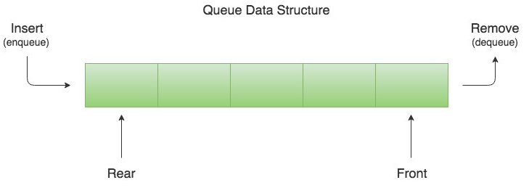
What is a Queue?
A Queue is a First In First Out (FIFO) data structure. It models a queue in real-life.
Just like queues in real life, new elements in a Queue data structure are added at the back and removed from the front.
The process of adding an element at the back of the Queue is called Enqueue, and the process of removing an element from the front of the Queue is called Dequeue.

Slide 26
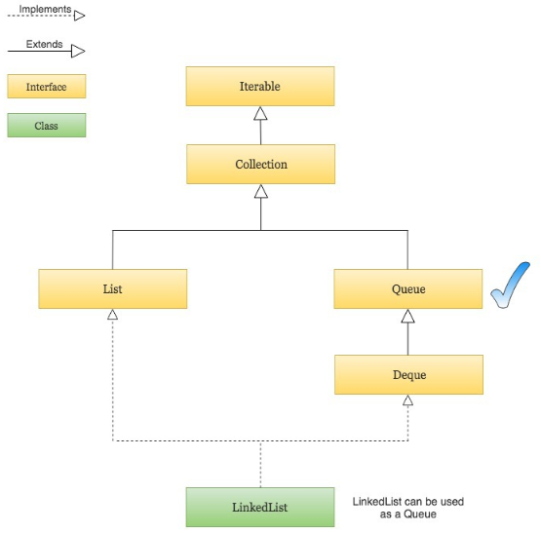
Java Queue
Java provides a Queue interface which is part of Java’s collections framework.
A Queue in Java is just an interface. We need a concrete implementation of the Queue interface to work with, in our programs.
As shown in the diagram above, the LinkedList class implements the Queue interface and therefore it can be used as a Queue.
It is in the package java.util.Queue;

Slide 27
Java Queue
Some common methods:
No. | Method | Description
1 | public void LinkedList () | It is a constructor of queue and used to create an empty queue.
2 | public boolean add(Object element) | It is used to insert any specific element at the end of a queue. As its return type is boolean, it returns true/false if the element is successfully or not added to the queue.
3 | public boolean offer(Object element) | It also adds the specified element to queue. It performs the same work as add() method.
4 | public Object remove() | It is used to retrieve or remove the head (the first element) of the queue and returns its value.
5 | public Object poll() | The poll() method is similar to remove () method, but the only difference is poll () returns null if the queue is empty.
6 | public Object peek() | returns the head of the queue
7 | public Object element() | returns the head of the queue. But difference between element() and peek() returns null if the queue is empty.
8 | public int size() | returns size of the queue.

Slide 28
Java Queue
Creating a Queue and Performing basic operations like Enqueue and Dequeue.
import java.util.LinkedList;
import java.util.Queue;
public class QueueExample {
public static void main(String[] args) {
// Create and initialize a Queue using a LinkedList
Queue<String> waitingQueue = new LinkedList<>();
// Adding new elements to the Queue (The Enqueue operation)
waitingQueue.add("Rajeev"); waitingQueue.add("Chris");
waitingQueue.add("John"); waitingQueue.add("Mark");
waitingQueue.add("Steven");
System.out.println("WaitingQueue : " + waitingQueue);
// Removing an element from the Queue using remove() ,throws NoSuchElementException if the Queue is empty
String name = waitingQueue.remove();
System.out.println("Removed from WaitingQueue : " + name + " | New WaitingQueue : " + waitingQueue);
// Removing an element from the Queue using poll(),it returns null if the Queue is empty.
name = waitingQueue.poll();
System.out.println("Removed from WaitingQueue : " + name + " | New WaitingQueue : " + waitingQueue);
}
}
Output:
WaitingQueue : [Rajeev, Chris, John, Mark, Steven]
Removed from WaitingQueue : Rajeev | New WaitingQueue : [Chris, John, Mark, Steven]
Removed from WaitingQueue : Chris | New WaitingQueue : [John, Mark, Steven]

Slide 29
Java Queue
Iterating over a Queue using iterator() and forEach() in Java 8.
import java.util.Iterator;
import java.util.LinkedList;
import java.util.Queue;
public class IterateOverQueueExample {
public static void main(String[] args) {
Queue<String> waitingQueue = new LinkedList<>();
waitingQueue.add("John");
waitingQueue.add("Brad");
waitingQueue.add("Angelina");
waitingQueue.add("Julia");
System.out.println("=== Iterating over a Queue using Java 8 forEach() ===");
waitingQueue.forEach(name -> {
System.out.println(name);
});
System.out.println("\n=== Iterating over a Queue using iterator() ===");
Iterator<String> waitingQueueIterator = waitingQueue.iterator();
while (waitingQueueIterator.hasNext()) {
String name = waitingQueueIterator.next();
System.out.println(name);
}
}
}
Output:
=== Iterating over a Queue using Java 8 forEach() ===
John
Brad
Angelina
Julia
=== Iterating over a Queue using iterator() ===
John
Brad
Angelina
Julia

Slide 30
Java Queue
Other Queue Operations: Check if the queue is empty, Find the size, Search for an element and get the element at the front of the Queue without removing it.
import java.util.LinkedList;
import java.util.Queue;
public class QueueSizeSearchFrontExample {
public static void main(String[] args) {
Queue<String> waitingQueue = new LinkedList<>();
waitingQueue.add("Jennifer"); waitingQueue.add("Angelina");
waitingQueue.add("Johnny"); waitingQueue.add("Sachin");
System.out.println("WaitingQueue : " + waitingQueue);
System.out.println("is waitingQueue empty? : " + waitingQueue.isEmpty());
System.out.println("Size of waitingQueue : " + waitingQueue.size());
String name = "Johnny";
if(waitingQueue.contains(name)) { System.out.println("WaitingQueue contains " + name); }
else { System.out.println("Waiting Queue doesn't contain " + name); }
// Get the element at the front of the Queue without removing it using element(), throws NoSuchElementException if the Queue is empty
String firstPersonInTheWaitingQueue = waitingQueue.element();
System.out.println("First Person in the Waiting Queue (element()) : " + firstPersonInTheWaitingQueue);
// Get the element at the front of the Queue without removing it using peek(), returns null if the Queue is empty
firstPersonInTheWaitingQueue = waitingQueue.peek();
System.out.println("First Person in the Waiting Queue : " + firstPersonInTheWaitingQueue);
}
}
Output:
WaitingQueue : [Jennifer, Angelina, Johnny, Sachin]
is waitingQueue empty? : false
Size of waitingQueue : 4
WaitingQueue contains Johnny
First Person in the Waiting Queue (element()) : Jennifer
First Person in the Waiting Queue : Jennifer

Slide 31
References
https://www.javatpoint.com/collections-in-java
https://viettuts.vn/java-collection
https://www.geeksforgeeks.org/collections-in-java-2/
https://howtodoinjava.com/java-collections/
https://viblo.asia/p/tong-quan-ve-collections-trong-java-maGK7E0Dlj2
https://www.tutorialspoint.com/java/java_collections.htm
https://www.journaldev.com/1260/collections-in-java-tutorial
https://www.callicoder.com/java-arraylist/
https://www.callicoder.com/java-queue/
https://www.callicoder.com/java-stack/

Slide 32


